Slide 1

RC Car for the visually or Hearing Impaired
01
경북과학고등학교 ICARUS

Slide 2
Motivation
Recently, many companies are developing self-driving cars. As this is a technology that is emerging these days, it is worth learning about so much that I thought about making products that use self-driving technology.
When I was thinking about what I could do with self-driving technology, I decided to develop a technology that could help the disabled.

Slide 3
Outline
Launching Object Detection through OpenCV of information entered in Pi Camera.
Determine the driving judgment and driving strategy through CNN and RNN and create the driving path based on the driving strategy determined.
Transmits artificial intelligence into RC cars through Wifi communication and implements vehicle control based on this decision.

Slide 4
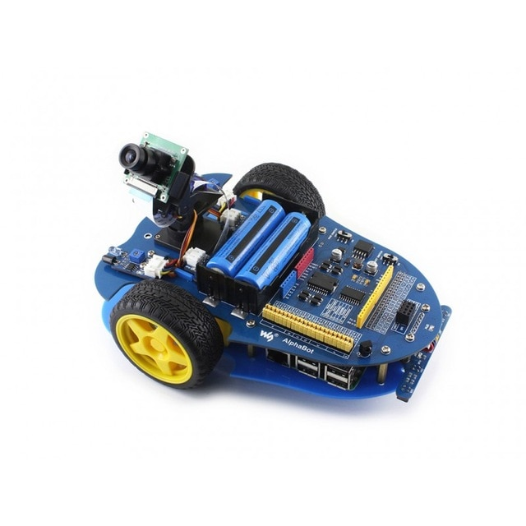
HW Component
AlphaBot 3
Camera rotation
Uses two 3.4V lithium ion batteries
Why we selected this: It supports many programs by mounting Raspberry Pi

Slide 5
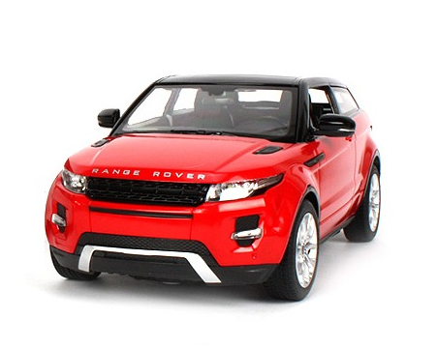
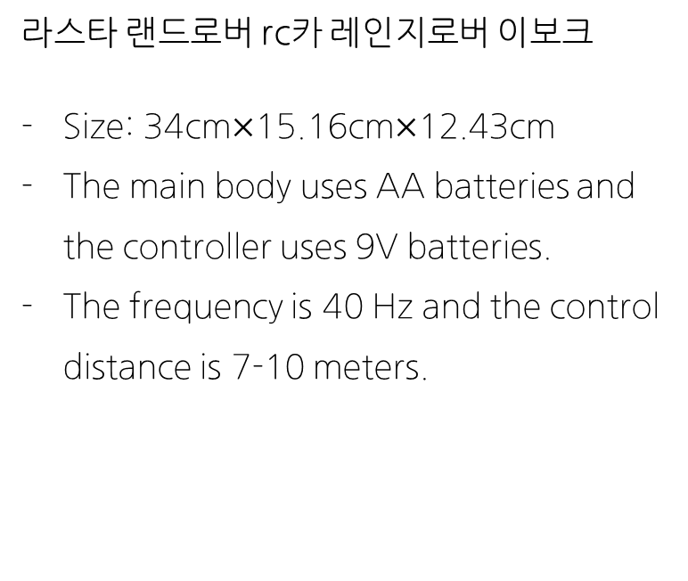
HW Component
라스타 랜드로버 rc카 레인지로버 이보크
Size: 34cm$×$15.16cm$×$12.43cm
The main body uses AA batteries and the controller uses 9V batteries.
The frequency is 40 Hz and the control distance is 7-10 meters.

Slide 6
Reasons for changing HW
Attempted to use Alpha Bot for price and efficiency, and for linkages with Raspberry Pi.
However, the RPM of both wheels was different, so we bought new hardware.
It was decided to use RC cars because they had excellent directional switching and propulsion compared to kit products.

Slide 7
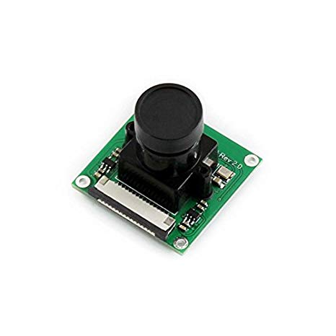
HW Component
RPi Camera (B)
Raspberry Pi Camera (B) Rev 2.0 with 1/4 inch 5MP OV5647 sensor is used. This camera can produce up to 1080p of images.

Slide 8
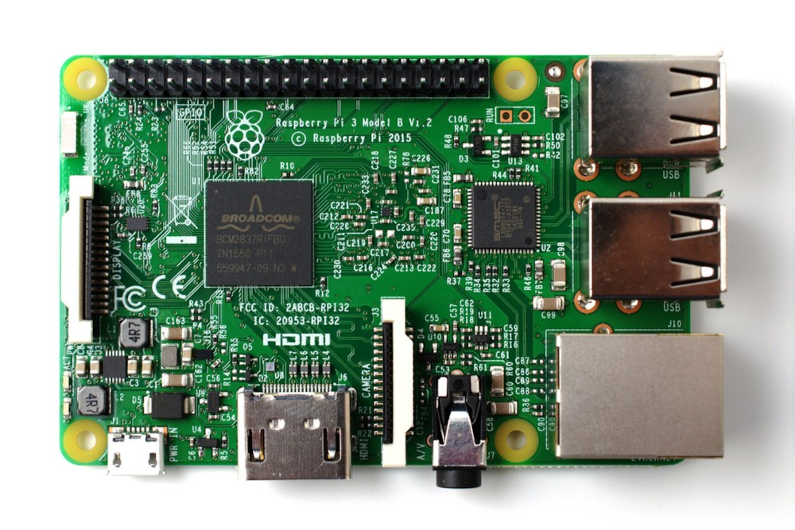
HW Component
Raspberry Pi 3 model B
CPU: 1.2GHz ARM Cortex-A53 MP4
RAM: 1 GB LPDDR2
Price: $35.00
Reason for selection: Arduino was initially considered, but this was chosen instead of Arduino because the Raspberry Pi provides a more convenient use of the wifi function and provides more diverse functions than the Arduino one.

Slide 9
Distinction
이곳에 내용을 입력해주세요 이곳에 내용을 입력해주세요 이곳에 내용을 입력해주세요 이곳에 내용을 입력해주세요
이곳에 내용을 입력해주세요 이곳에 내용을 입력해주세요 이곳에 내용을 입력해주세요 이곳에 내용을 입력해주세요
이곳에 내용을 입력해주세요 이곳에 내용을 입력해주세요 이곳에 내용을 입력해주세요 이곳에 내용을 입력해주세요
이곳에 내용을 입력해주세요 이곳에 내용을 입력해주세요 이곳에 내용을 입력해주세요 이곳에 내용을 입력해주세요
이곳에 내용을 입력해주세요 이곳에 내용을 입력해주세요 이곳에 내용을 입력해주세요 이곳에 내용을 입력해주세요
이곳에 내용을 입력해주세요 이곳에 내용을 입력해주세요 이곳에 내용을 입력해주세요

Slide 10
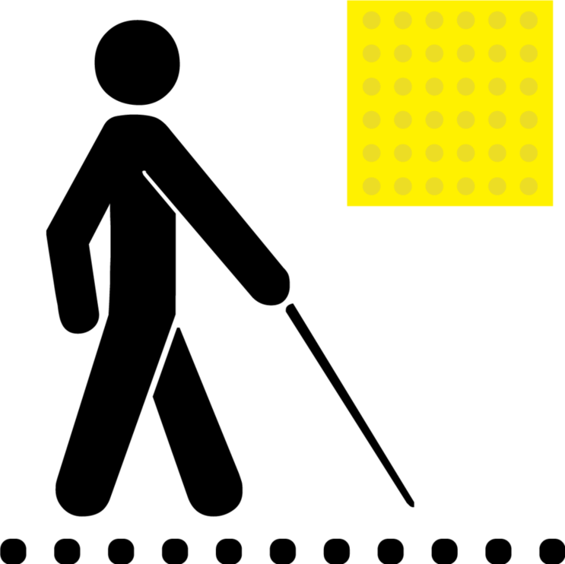
Development effect
If this robot is developed, visually impaired people can communicate with the world.
It facilitates the walking of visually impaired people and hearing impaired people.
It reduces the possibility of accidents in the event of emergency for people with hearing and hearing impairments.
.

Slide 11
Software Component
Development language: Python
Library:
OpenCV-Python: Use in image processing
Tensorflow: Implementing and learning an artificial intelligence model
Other Modules
Raspberry Pi install OS: Raspbian

Slide 12
Use tools
개발 언어: Python
사용 라이브러리:
OpenCV-Python: 영상처리에 활용
Tensorflow: 인공지능 모델 구현 및 학습에 활용
기타 모듈
Raspberry Pi 설치 OS: 라즈비안

Slide 13
Development Operating Environment
개발 언어: Python
사용 라이브러리:
OpenCV-Python: 영상처리에 활용
Tensorflow: 인공지능 모델 구현 및 학습에 활용
기타 모듈
Raspberry Pi 설치 OS: 라즈비안

Slide 14
개발 단계별 기간 및 인원
Participation personnel(4 people): 김무선, 강문재, 이준서, 김석준
0: Getting various guidance from Professor Yoon Eun-young of Computer Engineering through R&E
1: Test basic operation of RC cars with raspberry pie
2: Development of Self-driving artificial intelligence using RNN and CNN
3: Label data for self-driving AI learning
4: Self-driving artificial intelligence using the above data
5: Implementation of self-driving technology through communication between RC car and TCP server using Wifi
6: Self-driving test of RC car after basic course construction

Slide 15
역할분담
강문재
김무선
김석준
이준서

Slide 16
Algorithm
The server PC collects training data by human’s controlling the RC car with the keyboard.
The server receives visual data from Raspberry Pi via network socket.
The server runs artificial neural networks such as CNN, RNN, FC, so that it can determine the direction where the RC Car will go.
Raspberry Pi receives the direction data from the server via network, and it automatically steers the motors.
!Bienos Lias!

Slide 17
Flowchart
Camera
Router A
Raspberry Pi
Socket
(Python)
Server PC
Motor
Router B

Slide 18
사용 도구
 | Python 3.6
 | opencv

Slide 19
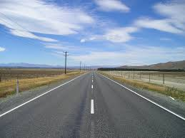

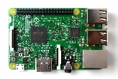

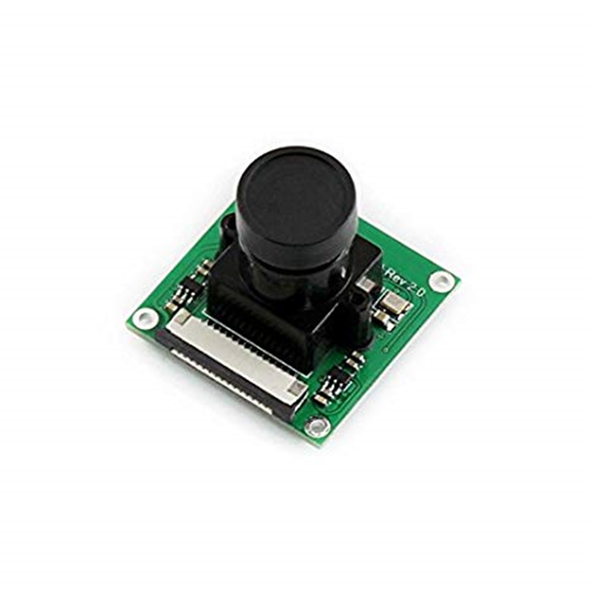
데이터 레이블링
Pi camera가 실시간으로 사진을 찍고 이미지를 픽셀로 변환
당시 RC카의 주행방향 정보(키보드 : 앞, 뒤, 왼, 오)와 함께
행렬 데이터로 저장
네트워크를 이용해
직접만든 도로를 따라
키보드로 RC카 조종
레이블 된 데이터 생성

Slide 20
학습
https://github.com/hamuchiwa/AutoRCCar 참고

Slide 21
Development method
https://github.com/hamuchiwa/AutoRCCar 참고

Slide 22
How to use
1. RC카 전원을 키고 바닥에 놓는다
2.
3.
4. 자율주행 하는 차량으로 부터 도움을 받는다

Slide 23
Running
참여 인원(4명): 김무선, 강문재, 이준서, 김석준
0: R&E를 통하여 컴퓨터 공학과 윤은영 교수님께 다양한 지도를 받음
1: 라즈베리 파이를 통한 RC카 기본적인 작동 테스트
2: RNN과 CNN을 활용하여 자율주행 인공지능 개발
3: 자율주행 인공지능 학습에 사용할 데이터 라벨링
4: 위 데이터를 이용하여 자율주행 인공지능 학습
5: Wifi를 이용하여 RC카와 TCP 서버간 통신을 통해 자율주행 구현
6: 기본적인 코스 제작 후 RC카 자율주행 테스트

Slide 24
Demo
시연 영상 준비중

Slide 25
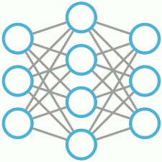
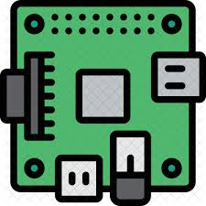



Project Diagram
Raspberry Pi
CNN, RNN
Server
RC car

Slide 26
PROCESS
OF OUR
PROJECT
도우미 로봇은..
START
시청각장애인들의 보행에 도움을 주는 자율주행 로봇이다.

Slide 27
Network Socket
We used network sockets on Python for the communication between the server PC and Raspberry Pi
START
PROJECT
Receiving Camera Data
The server PC receives camera data from Raspberry Pi via network

Slide 28
Neural Network
The server pc runs some neural networks to determine the direction
START
PROJECT
Steering
Raspberry Pi receives the direction data from the server PC, and it autonomously steers the motors

Slide 29
PROCESS
OF OUR
PROJECT
자율주행
FINISH
전달 받은 신호를 통하여 RC카의 자율주행 시행 및 이를 통하여 시청각장애인을 도움

Slide 30
FINISH
OUR PRESENTATION THANK YOU

